Slide 1
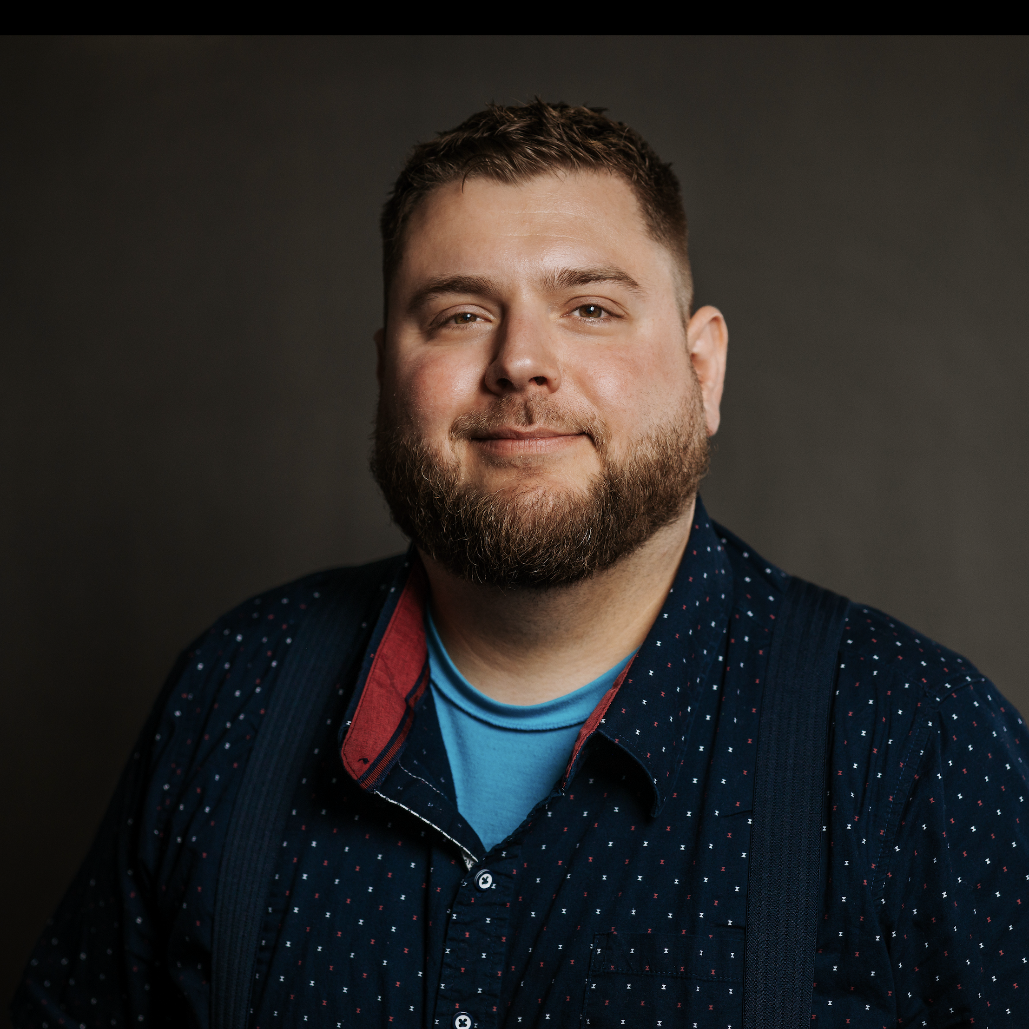
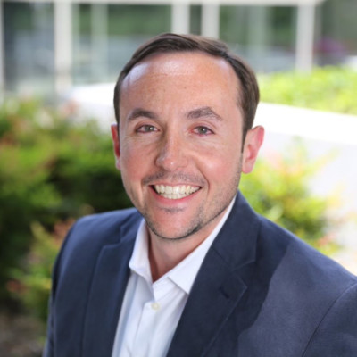
Michael Carbone Senior Consultant — Acceleration
Email
michael.carbone@thebridge.com
Location
Chicago, IL
Mobile
(815) 545-9205
Michael joined The Bridge in June 2023. He previously worked at Millennium Trust Company for 3 years, where he developed the skills and passion for both Project Management and Agile Delivery, he now uses to help teams achieve higher levels of success and grow together.
EXPERIENCE
Industry Experience
Financial Services | Food Distribution | Consumer Price Goods
IT Management Consultant | The Bridge
Managed a team of Data Experts through a Cloud Data Platform implementation for a large CPG firm, ensuring we delivered on time and at/under budget throughout the engagement, escalating risks and roadblocks as well as reporting progress
Served as Project Manager for 2 teams of data experts (architects, engineers and data scientists) to analyze the data estate for a Luxury Travel Company and a large CPG firm to identify and solution for areas of exposure in both data governance and data optimization
Served as Business Analyst/ Scrum Master on a Scrum team for a large Food Distributor client that was amidst a core transformation from an older legacy system to a new client facing application. ​
Hosted Discovery sessions with both business and IT partners to gain a deeper understanding of the vision of the product as well as the technical limitations that may hinder our progress in development​
Upheld Agile principles and ceremonies, facilitating daily Stand-ups, Backlog refinement sessions, Sprint Planning meetings, Sprint Demo's and Sprint Retrospectives​
Owned teams Sprint and Kanban boards as well as wrote both FE and BE User Stories
Scrum Master | Millennium Trust Company
Served as a Scrum Master on an Agile team focusing our efforts around building an employer sponsored ESA (Emergency Savings Account) a financial services product similar to an HSA/FSA offered to on-shore small to mid-sized businesses to add to their employee benefit packages ​
Implemented a Working Agreement within the team, ensuring all members always in sync on roles and responsibilities​
Collaborated with team to establish a Definition of Done​
Managed team Sprint board and created all User Stories for the team
BACKGROUND
Functional Skills
Facilitation of meetings, Agile fundamentals, Time Management, Discovery, Project coordination, Cross team communication, User Story writing, Budgeting and Forecasting, Data Project Management, Platform Build, D365 Integration, Microsoft Fabric
Certifications
(CSM) Certified Scrum Master, Scrum Alliance ​ (PSM1) Professional Scrum Master, Scrum.org ​ SAFe 5.0 Scrum Master

Slide 2


Email
michael.carbone@thebridge.com
Location
Chicago, Illinois
Mobile
(815) 545-9205
Michael joined The Bridge in June 2023. He previously worked at Millennium Trust Company for 3 years, where he developed the skills and passion for both Project Management and Agile Delivery, he now uses to help teams achieve higher levels of success and grow together.
Michael Carbone Senior Consultant
Acceleration

Slide 3
Michael Carbone Senior Consultant — Acceleration
Email
michael.carbone@thebridge.com
Mobile
(815) 545-9205
Location
Chicago, Illinois
BACKGROUND
EXPERIENCE
Functional Skills
Facilitation of meetings, Agile fundamentals, Time Management, Discovery, Project coordination, Cross team communication, User Story writing, Budgeting and Forecasting, Data Project Management, Platform Build, D365 Integration, Microsoft Fabric
Certifications
(CSM) Certified Scrum Master, Scrum Alliance ​ (PSM1) Professional Scrum Master, Scrum.org ​ SAFe 5.0 Scrum Master
Industry Experience
Financial Services | Food Distribution
IT Management Consultant | The Bridge
Managed a team of Data Experts through a Cloud Data Platform implementation for a large CPG firm, ensuring we delivered on time and at/under budget throughout the engagement, escalating risks and roadblocks as well as reporting progress
Served as Project Manager for 2 teams of data experts (architects, engineers and data scientists) to analyze the data estate for a Luxury Travel Company and a large CPG firm to identify and solution for areas of exposure in both data governance and data optimization
Served as Business Analyst/ Scrum Master on a Scrum team for a large Food Distributor client that was amidst a core transformation from an older legacy system to a new client facing application. ​
Hosted Discovery sessions with both business and IT partners to gain a deeper understanding of the vision of the product as well as the technical limitations that may hinder our progress in development​
Upheld Agile principles and ceremonies, facilitating daily Stand-ups, Backlog refinement sessions, Sprint Planning meetings, Sprint Demo's and Sprint Retrospectives​
Owned teams Sprint and Kanban boards as well as wrote both FE and BE User Stories
Scrum Master | Millennium Trust Company
Served as Scrum Master on an Agile team focusing our efforts around building an employer sponsored ESA (Emergency Savings Account) a financial services product similar to an HSA/FSA offered to on-shore small to mid-sized businesses to add to their employee benefit packages ​
Implemented a Working Agreement within the team, ensuring all members always in sync on roles and responsibilities​
Collaborated with team to establish a Definition of Done​
Managed team Sprint board and created all User Stories for the team

